Slide 1


NYC Taxi Tip Prediction
By Ashley Kim & John Park

Slide 2
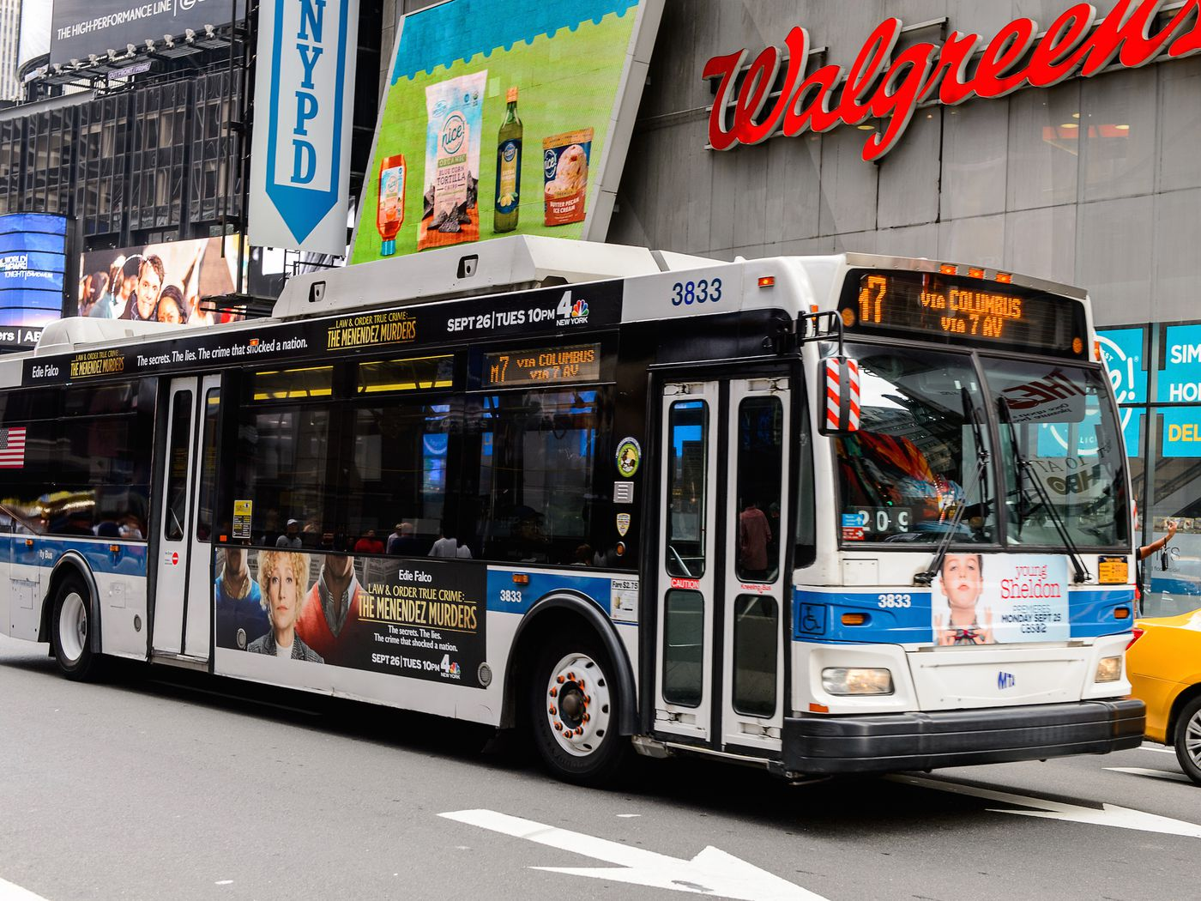


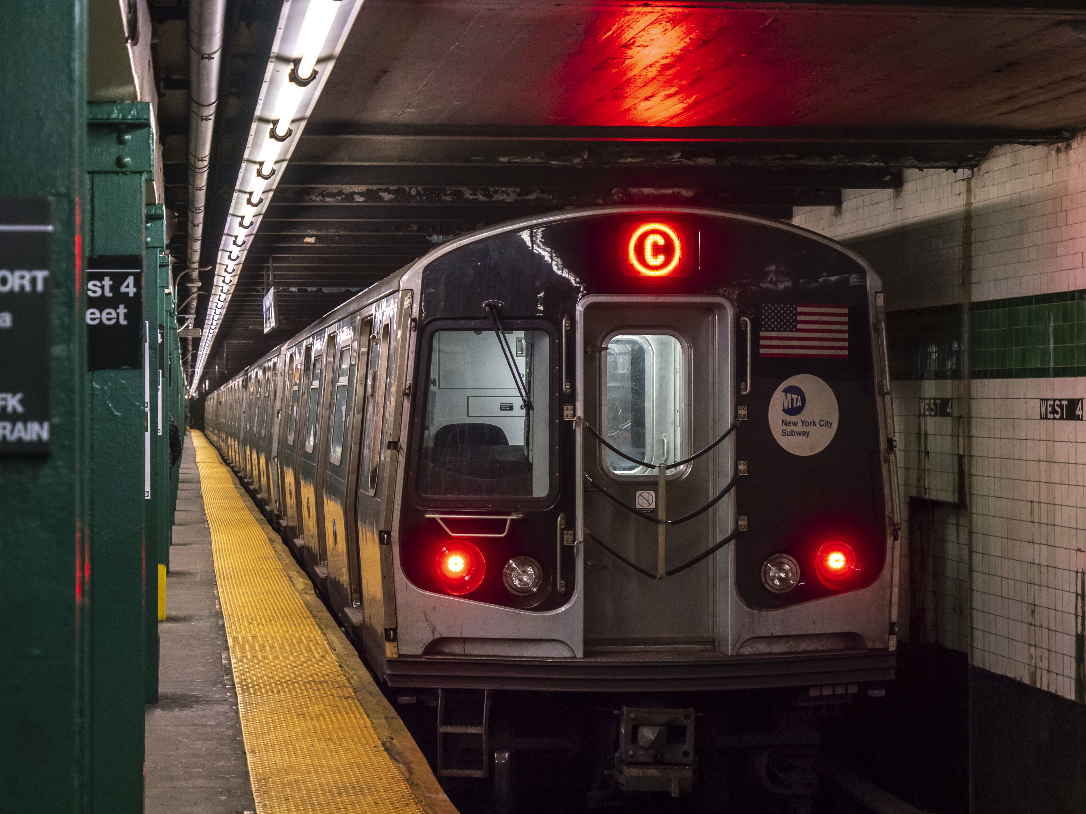

BACKGROUND
Tipping Issues in a high cost of living city
Notes:
Introduction
Tipping in ride services reflects a mix of behavioral, economic, and contextual factors. This project investigates tipping patterns in New York City’s taxi and for-hire vehicle services using 2023 trip data from the TLC, alongside neighborhood income data. By analyzing trends across time, trip characteristics, and geography, the study aims to uncover how socioeconomic context shapes rider behavior and inform broader conversations around equity and compensation in urban mobility.
New York City has the most taxicabs in the United States
How much do you guys tip when you guys take ubers, lyfts or taxis?

Slide 3
Research Question
What factors influence the percentage of tips given on taxi rides in New York City, based on ride characteristics, time, and neighborhood characteristics?

Slide 4
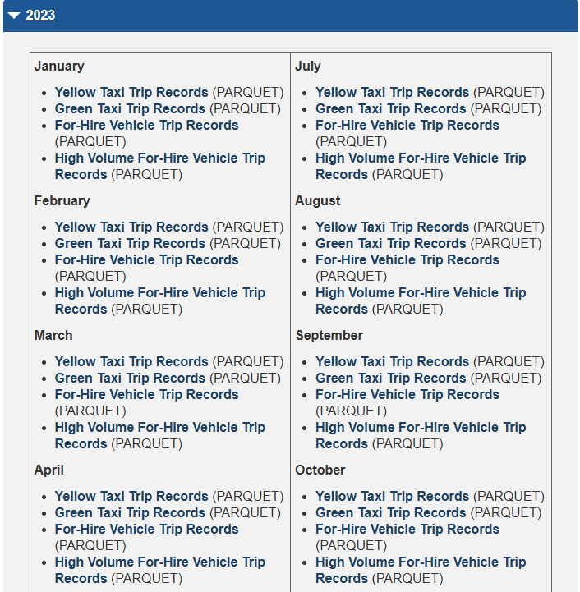
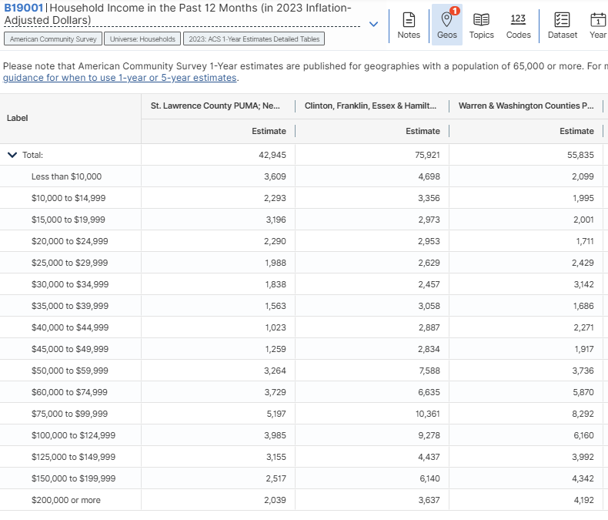
Tractable Data
NYC Taxi & Limousine Commission
data on ridership, licensing, and vehicle performance in NYC
American Community Survey
detailed data on demographics, social characteristics, economics, and housing across the U.S
Notes:
Ridership data from NYC Taxi & Limousine Commission
Income data from American Community Survey

Slide 5
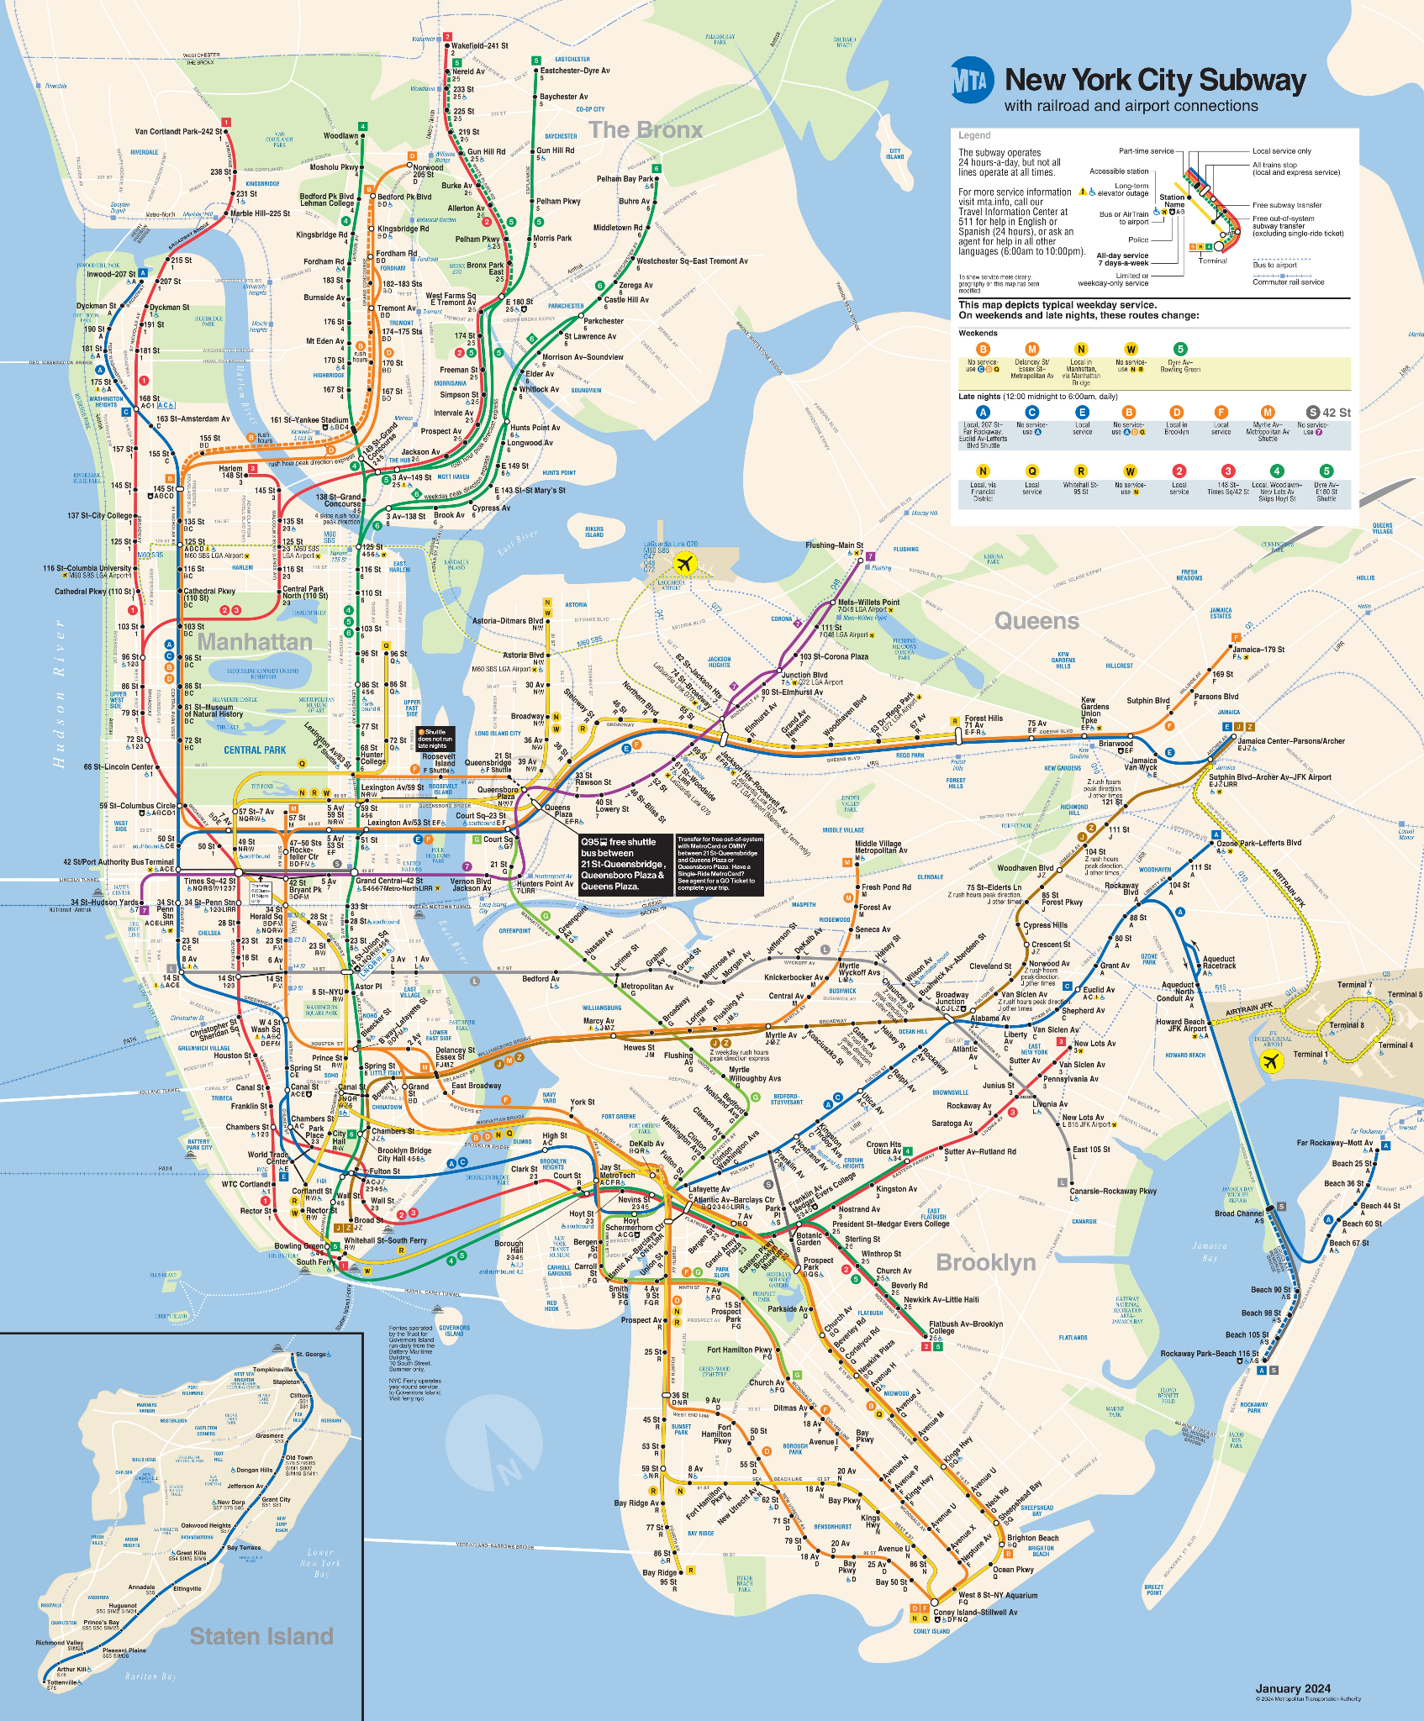
Data Retrieval
Downloaded parquet files from NYC TLC :
Yellow Taxi Trip Records (PARQUET)
Green Taxi Trip Records (PARQUET)
For-Hire Vehicle Trip Records (PARQUET)
High Volume For-Hire Vehicle Trip Records (PARQUET)
Year: 2023 (Mar., Jun., Sep., Dec.)
Downloaded csv file from ACS:
Houshold Income (csv)
1-Year Estimates, Summary Table B19001 (2023)
Notes:
Parquet files from NYC TLC for 2023 March, June, Sep, Dec.
Houshold income data which were in csv file format from ACS for 2023

Slide 6
Data Cleaning & Preprocessing
Included 2023 taxi data from March, June, Sept, Dec to identify seasonal trends
1st week of each month starting on Monday, dataset too big
Merging
Left join taxi transaction data and neighborhood income data on pickup and dropoff location_id
Dropped Extreme Outliers
Trip distance over 50 miles
Pickup / Dropoff location Outside of NYC
Fare_amount under $0
Notes:
Used 1st week of each month starting monday for the 4 months as the dataset was too big
Merged the taxi transaction data and neighborhood income data on PU and DO location id
Dropped extreme outliers

Slide 7
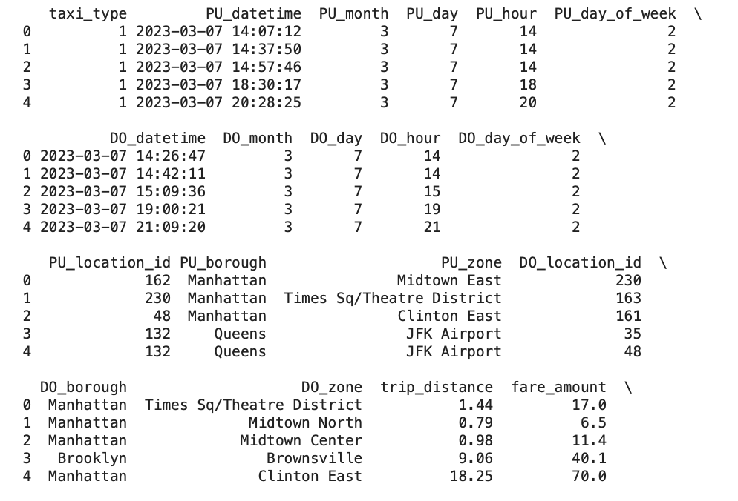
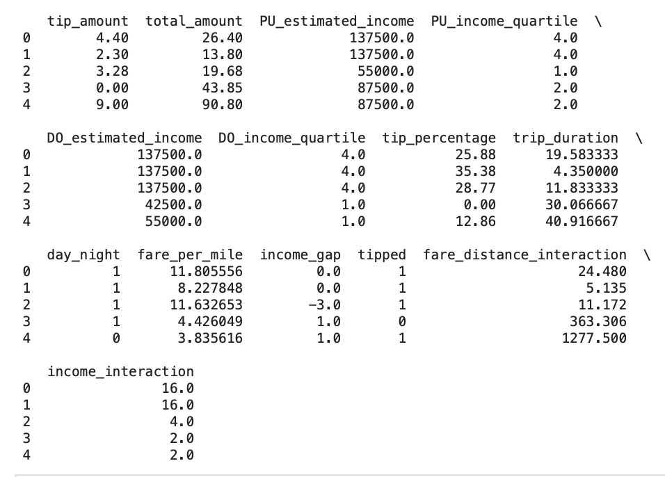
Cleaned Data
How many columns and rows?
=> 20,995,620 rows, 26 columns
Notes:
Split into PU/DO time, income, zone, borough to capture differences
As a result, we had 21 million rows and 26 columns

Slide 8
Exploratory Data Analysis

Slide 9
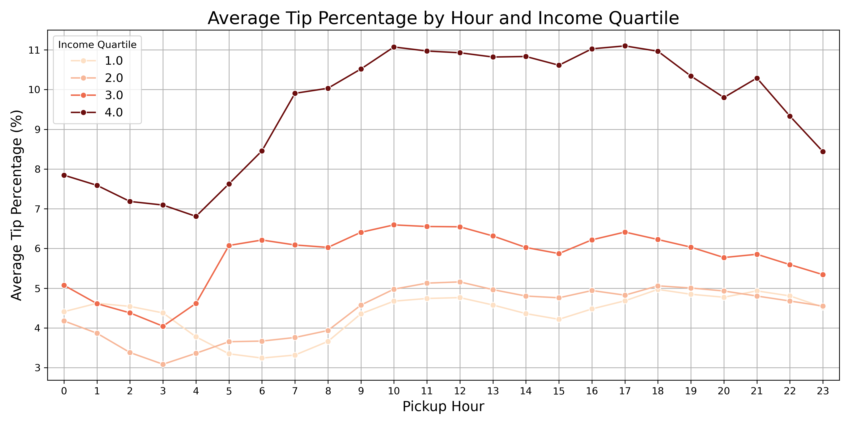
EDA
Notes:
Tip percentages were higher for income quartile 4 areas. Tip percentages increase starting at around 4-5am and decrease at around 8-9pm

Slide 10
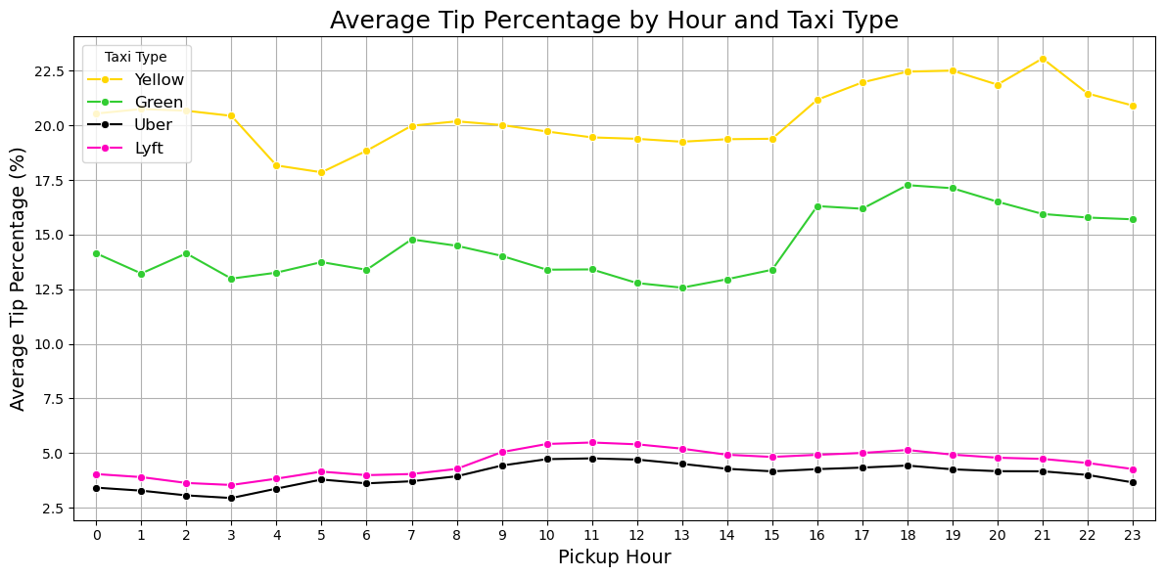
EDA
Notes:
Tip % much higher for green and yellow cabs
Uber and lyft rides had low tip percentage compared to yellow and green cabs

Slide 11
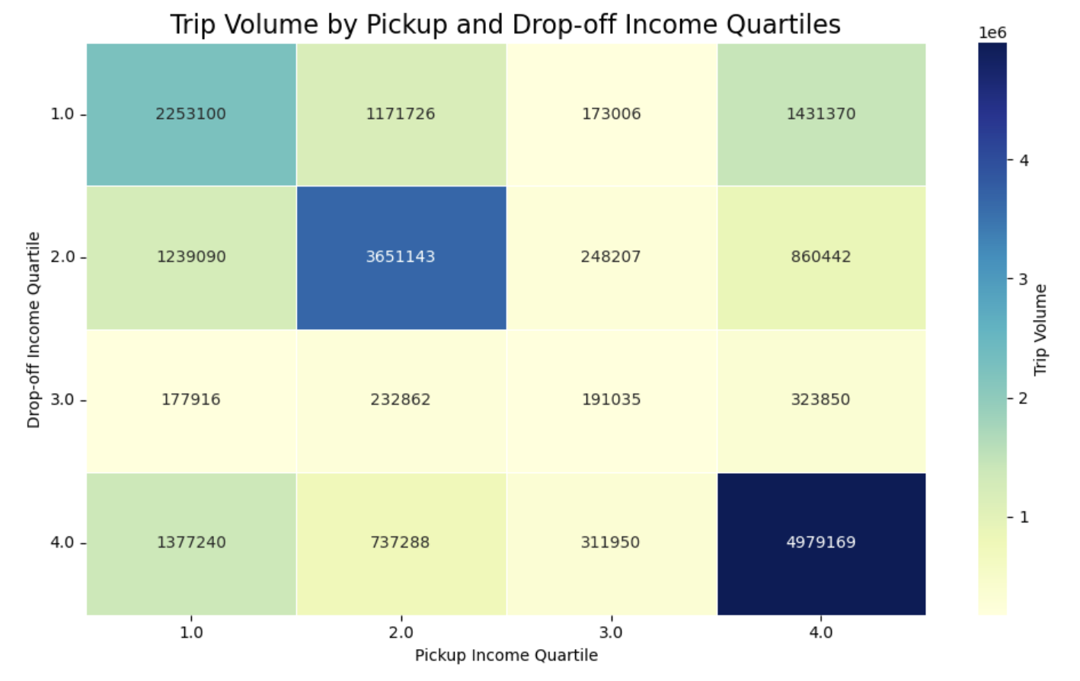
EDA
Notes:
Most rides were within the same income quartiles
Income quartile 4: had the biggest trip volume compared to other

Slide 12
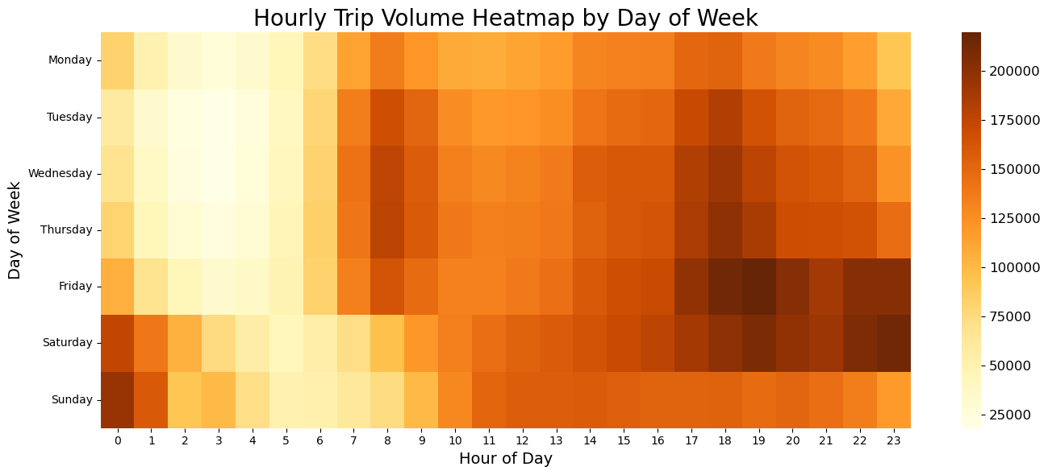
EDA
Notes:
Higher trip volume on friday and saturday nights, and low trip volume on weekday early mornings

Slide 13
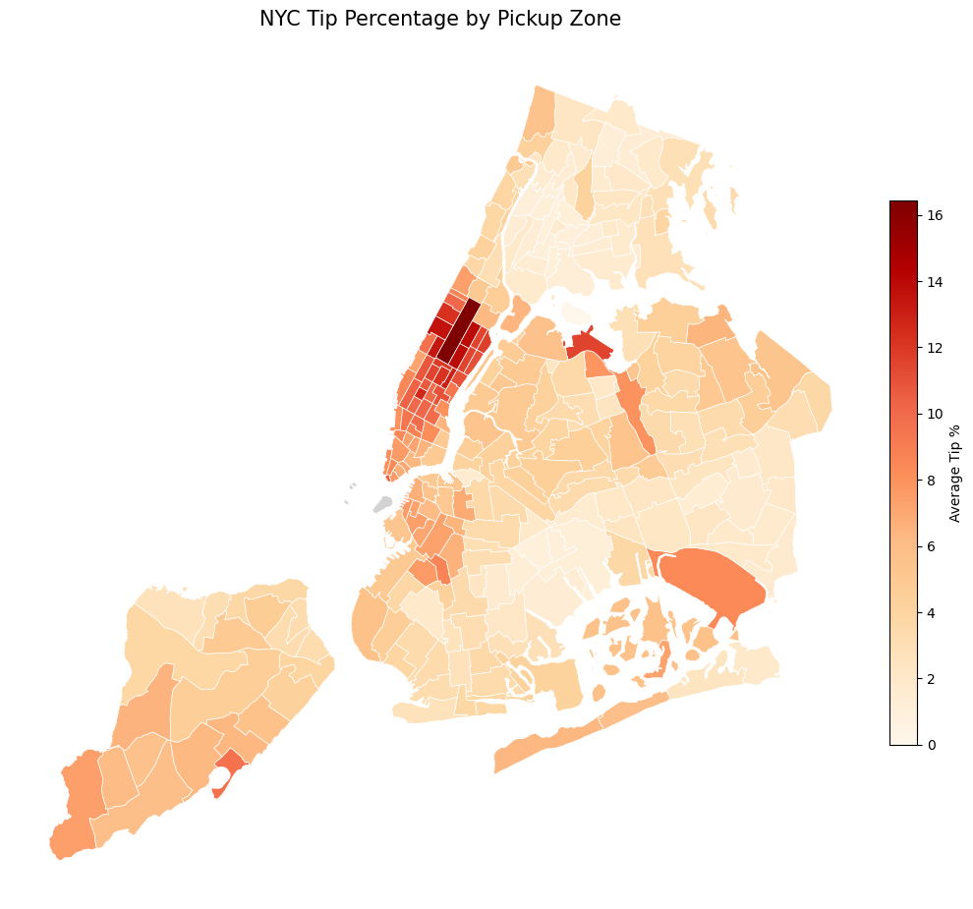
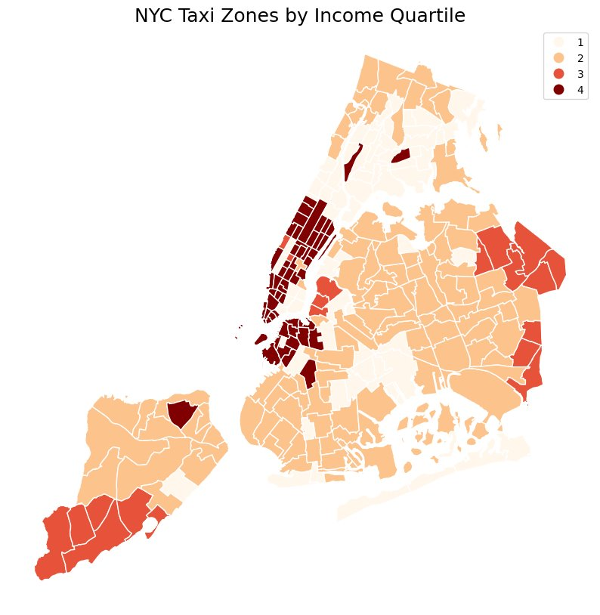
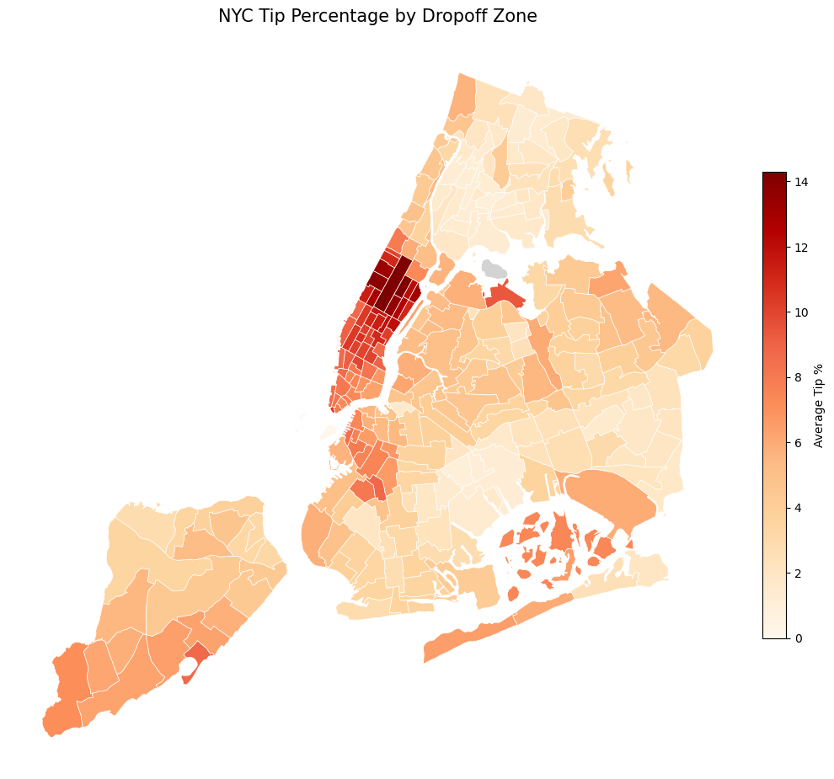
EDA
Notes:
Income quartile maps for NYC taxi zone
Tip % by pick up zone were high in high income quartile areas
Similar for drop off zone

Slide 14
Modeling Objective
Predict the tip percentage for taxi/Uber/Lyft rides in NYC based on ride, time, and location-related features.
Notes:
Linear Regression (explain why we used it)
Residual (explain the reason for getting rid of >100% tips)
Light GBM (explain why we chose the model

Slide 15
Model Specification
OLS Regression:
Applied to explore the relationship between multiple variables and tip percentage.
Numeric prediction for feature engineering’s performance.
LightGBM (Gradient Boosted Trees):
Chosen for its ability to handle nonlinearities and complex interactions between features.
This model improves prediction accuracy by automatically modeling complex relationships between variables like taxi type, trip duration, and fare per mile.
LightGBM is optimized for handling large datasets efficiently.
Notes:
Didn't use random forest as our dataset was too large

Slide 16
Feature Engineering
Category | Features
Time | day_night = Split time into Day 6am – 6pm, Night 6pm – 6am
Trip Characteristics | trip_duration = (Drop off time) - (Pick up time) fare_per_mile = (fare amount) / (trip distance) Tipped = Binary classification whether tipped or not Taxi_type = (yellow, green, Uber, Lyft)
Socioeconomic | income_quartile = 1. 32500 – 55000 2. 67500 – 87500 3. 105500 – 122500 4. 137500 – 175000 income_interaction = (PU_income_quartile) x (DO_income_quartile)
Notes:
Income Interaction Origin and destination income levels can affect the tipping culture of the passenger or the socioeconomic context of the trip:
High → High: wealthier passengers tipping well.
Low → Low: limited tipping.
Low → High or High → Low: may suggest commutes, service routes, or delivery drivers.
Interpretation: This feature allows the model to capture tipping norms associated with cross-income area travel, not just isolated PU or DO income levels.

Slide 17
Feature Overview
Category | Features
Time | PU_day_of_week, PU_hour, DO_day_of_week, DO_hour, day_night
Trip Characteristics | trip_distance, fare_amount, trip_duration, fare_per_mile, tipped
Categorical | taxi_type
Socioeconomic | PU_income_quartile, DO_income_quartile, income_interaction
Target Variable
tip_percentage = (tip_amount / fare_amount) *100

Slide 18
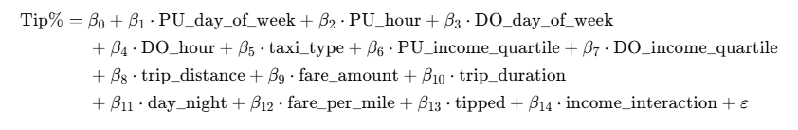
Linear Regression
Mean Squared Error (MSE): 50.8365
Root Mean Squared Error (RMSE): 7.1300
Mean Absolute Error (MAE): 2.6194
R² Score: 0.6870
Adjusted R² Score: 0.6870
Notes:
High MSE score
MAE = 2.61 → on average, your model's predictions are off by 2.61 percentage points.
RMSE = 7.1 → larger errors are penalized more heavily; gives a sense of worst-case average deviation.
Adjusted R² = 0.6865 → nearly identical to R² because your model is well-balanced.

Slide 19
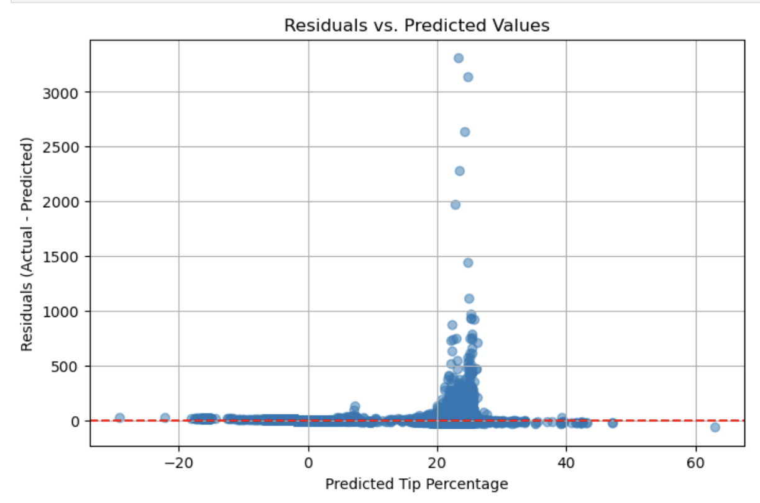
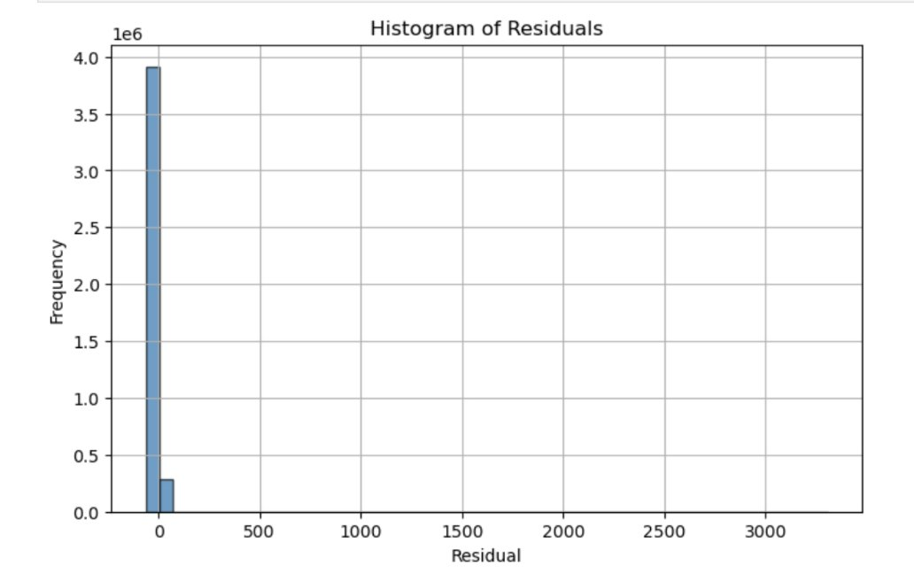
Linear Regression
Removed tip percentage over 100%
Notes:
Residual Plot
Heavy vertical spike around predicted tip ~20%, with residuals shooting above 3000
Some negative predicted values and outliers above 1000, which are not realistic for tip percentages.
Residuals are not randomly scattered, which means model bias exists
Outliers are heavily affecting the model
Histogram
Massive spike near 0
But extremely long right tail — residuals in the hundreds or thousands, which is not plausible in a tip % context.
model is heavily affected by extreme values

Slide 20
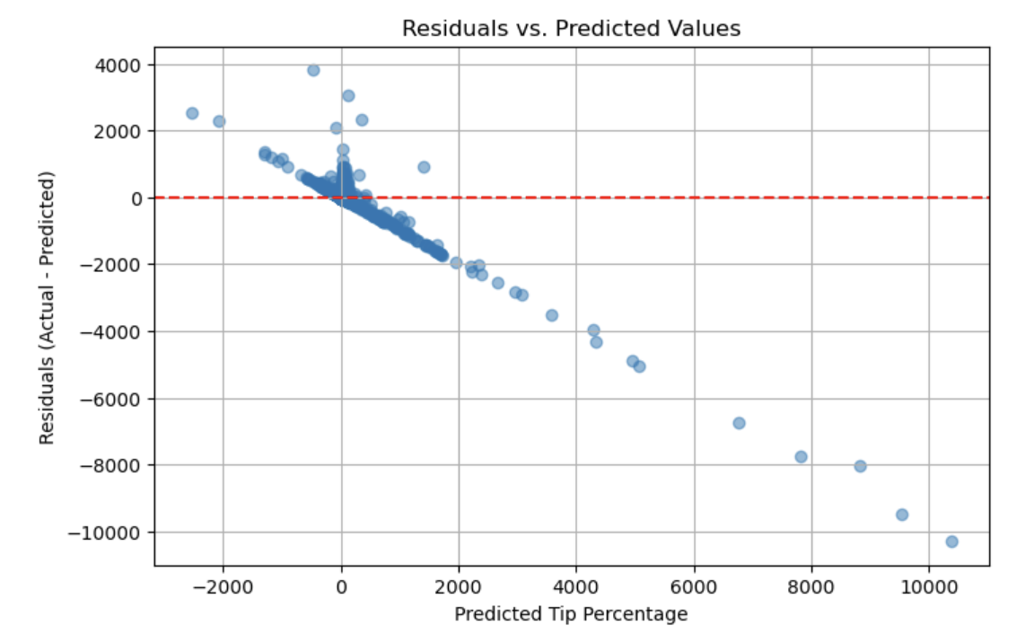
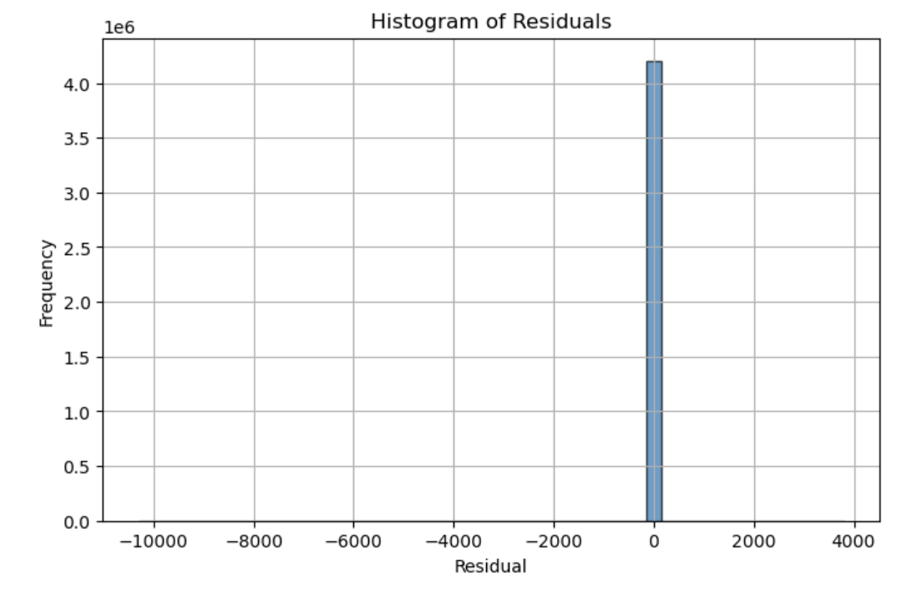
Light GBM
Mean Squared Error (MSE): 192.4377 Root Mean Squared Error (RMSE): 13.8722 Mean Absolute Error (MAE): 1.9901 R² Score: -0.1848 Adjusted R² Score: -0.1848
Notes:
A negative R² score -0.185 is a strong signal that the model is completely misfitting due to problematic data
Adjusted R² Score−0.185Confirms same issue, even accounting for feature count
🔎 Residuals vs. Predicted Values Plot
Observation: There’s a strong negative correlation between predicted values and residuals
Interpretation: This pattern suggests model misspecification, often caused by extreme outliers
Action: The scale of predicted values reaching 10,000% and residuals down to −10,000 indicates anomalous data skewing the model. Decided to remove tip percentages over 100%
(No Need to talk abt this)
📊 Histogram of Residuals
Observation: A very tall bar near 0, with a few extreme values stretching the x-axis.
Interpretation: Most residuals are small, but a handful of outliers dominate the scale. This compresses the rest of the data and hides informative distribution patterns.
Action: You need to filter or handle extreme residuals to regain interpretability and accurate model performance.

Slide 21
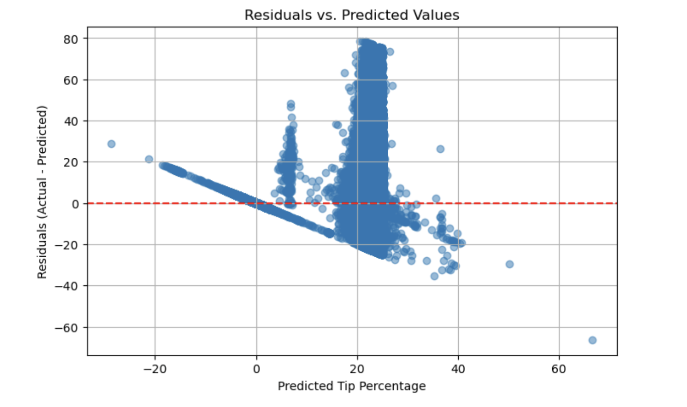
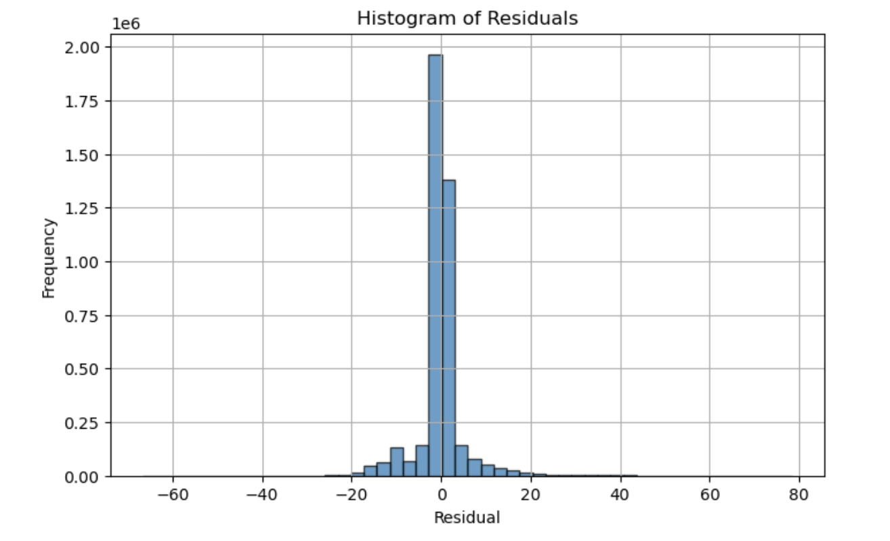
Linear Regression
After removing tip outliers over 100%
Mean Squared Error (MSE): 29.4093
Root Mean Squared Error (RMSE): 5.4230
Mean Absolute Error (MAE): 2.5377
R² Score: 0.7880
Adjusted R² Score: 0.7880
Notes:
📊 Evaluation Metrics:
MSE: 29.41 → Lower is better.
RMSE: 5.42
MAE: 2.54 → The average absolute difference between predicted and actual tip percentages is small and improved.
R² Score: 0.788 → a strong result for a linear regression.
Adjusted R²: 0.788 →
📉 Residuals vs. Predicted Plot:
Centered around 0, indicating minimal bias.
mostly randomly scattered, improved significantly
📈 Histogram of Residuals:
Tightly centered at 0 with a roughly normal distribution.
No extreme skew or outlier spikes.
This confirms that most predictions are close to actual values.

Slide 22
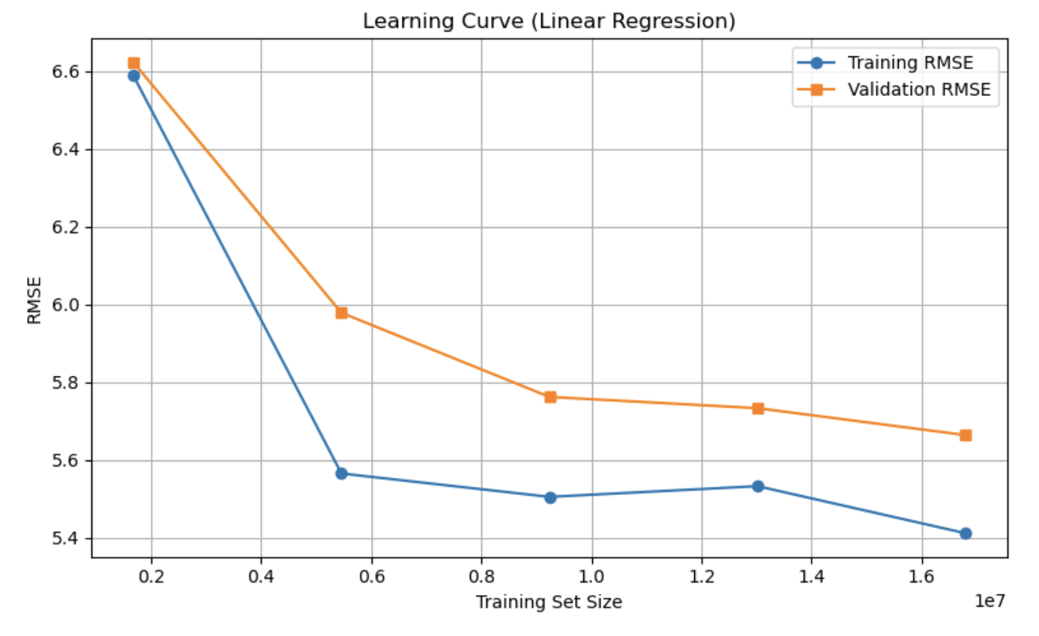
Linear Regression
Notes:
What This Curve Indicates
Low variance: The validation curve is close to training → the model generalizes well.
Mild bias: Since both curves plateau and don’t converge to zero, model isn’t underfitting badly, but linear regression has limited flexibility in modeling complex patterns.
Lead to tree modeling

Slide 23
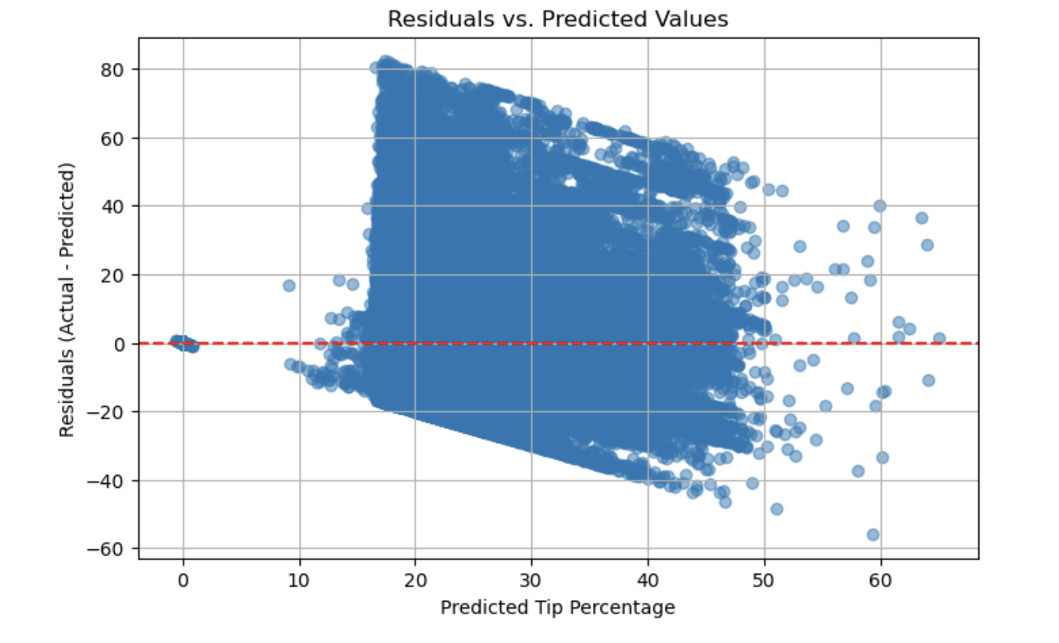
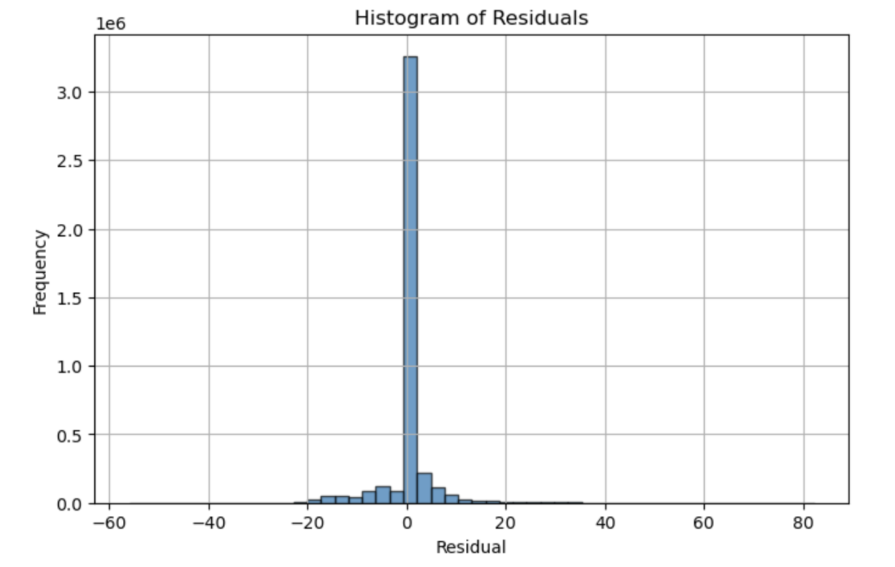
Light GBM
After removing tip outliers over 100%
Mean Squared Error (MSE): 23.7850
Root Mean Squared Error (RMSE): 4.8770
Mean Absolute Error (MAE): 1.8558
R² Score: 0.8285
Adjusted R² Score: 0.8285
Notes:
An R² of 0.8285 means that ~83% of the variance in tip percentage
✅ Strengths:
Very dense cloud of points around 0 residuals — most predictions are close.
Clear improvement over linear regression.
📊 Histogram of Residuals
✅ Interpretation:
Strong central peak around 0.
Symmetric and cleanly shaped → residuals are mostly unbiased
Normally distributed

Slide 24
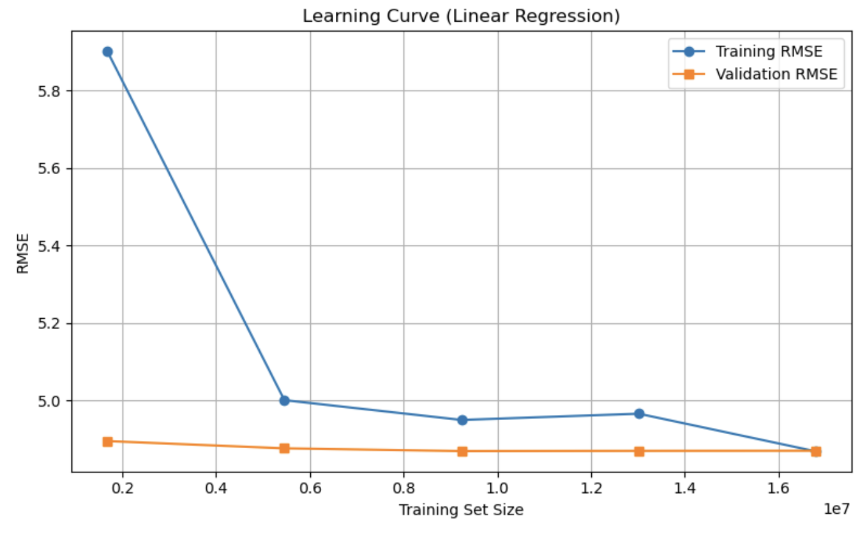
Light GBM
Learning Curve(Light GBM)
Notes:
📈 Learning Curve (LightGBM)
Both training and validation RMSE curves flatten and converge, indicating:
No high variance (overfitting).
No high bias (underfitting).
More training data may offer marginal improvements at best.
This is a healthy learning curve.

Slide 25
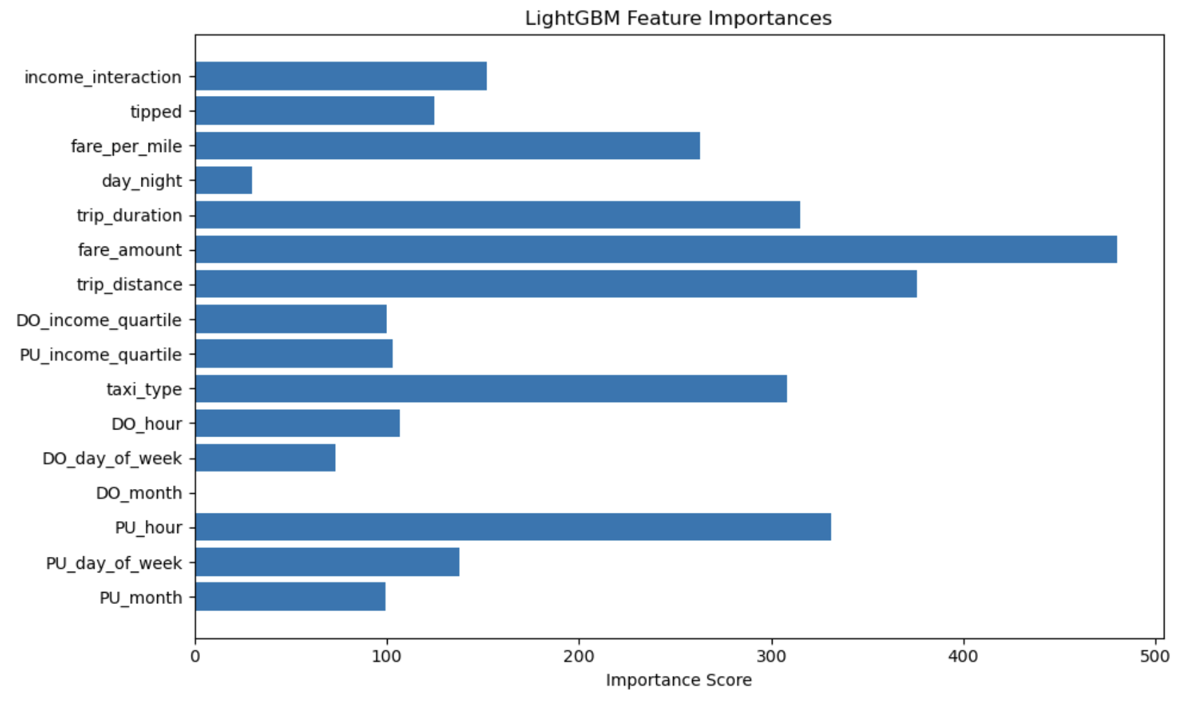
Feature Importance
Notes:
. LightGBM Feature Importance (Bar Plot)
fare_amount, trip_distance, PU_hour, and trip_duration are most used in tree splits.
Categorical variables like taxi_type, PU_income_quartile, and DO_income_quartile also contribute.
By default, LightGBM reports how often a feature is used to split in the decision trees:
If a feature is frequently used near the top of trees, it gets a higher score.

Slide 26
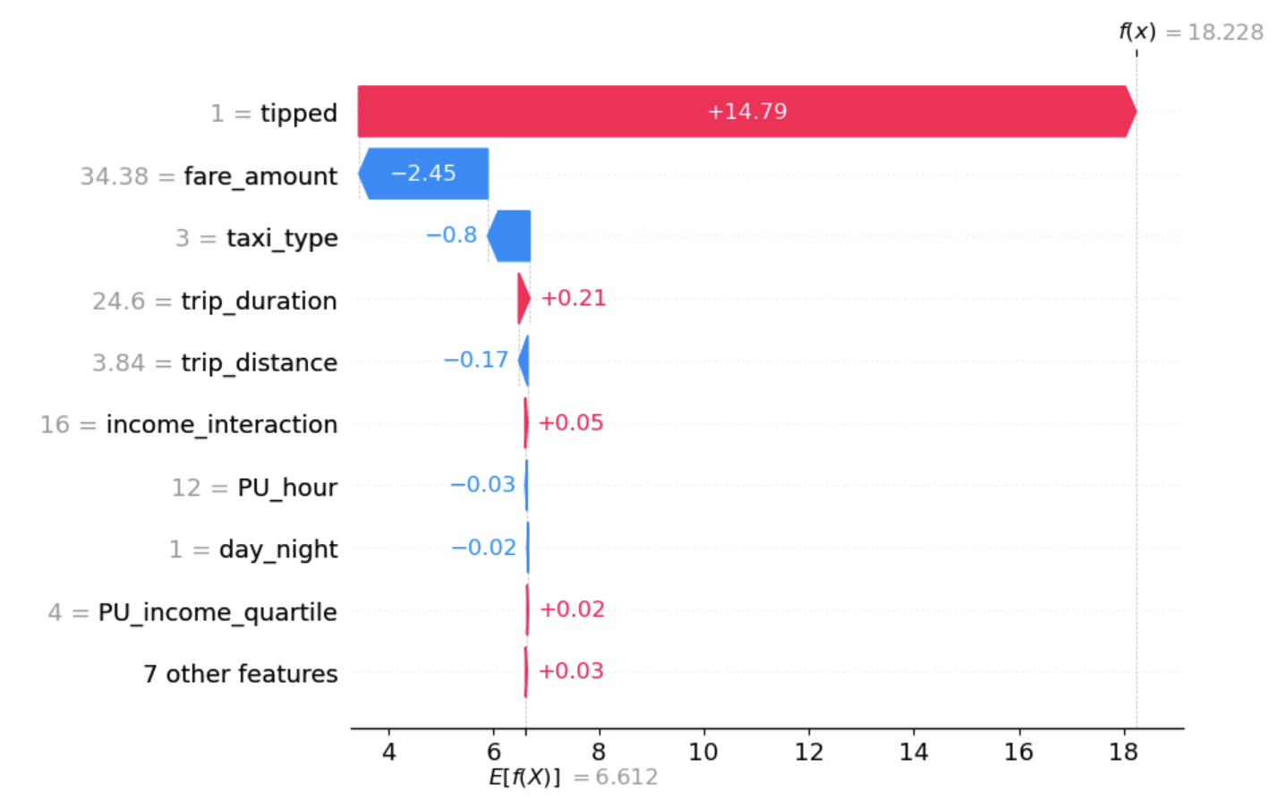
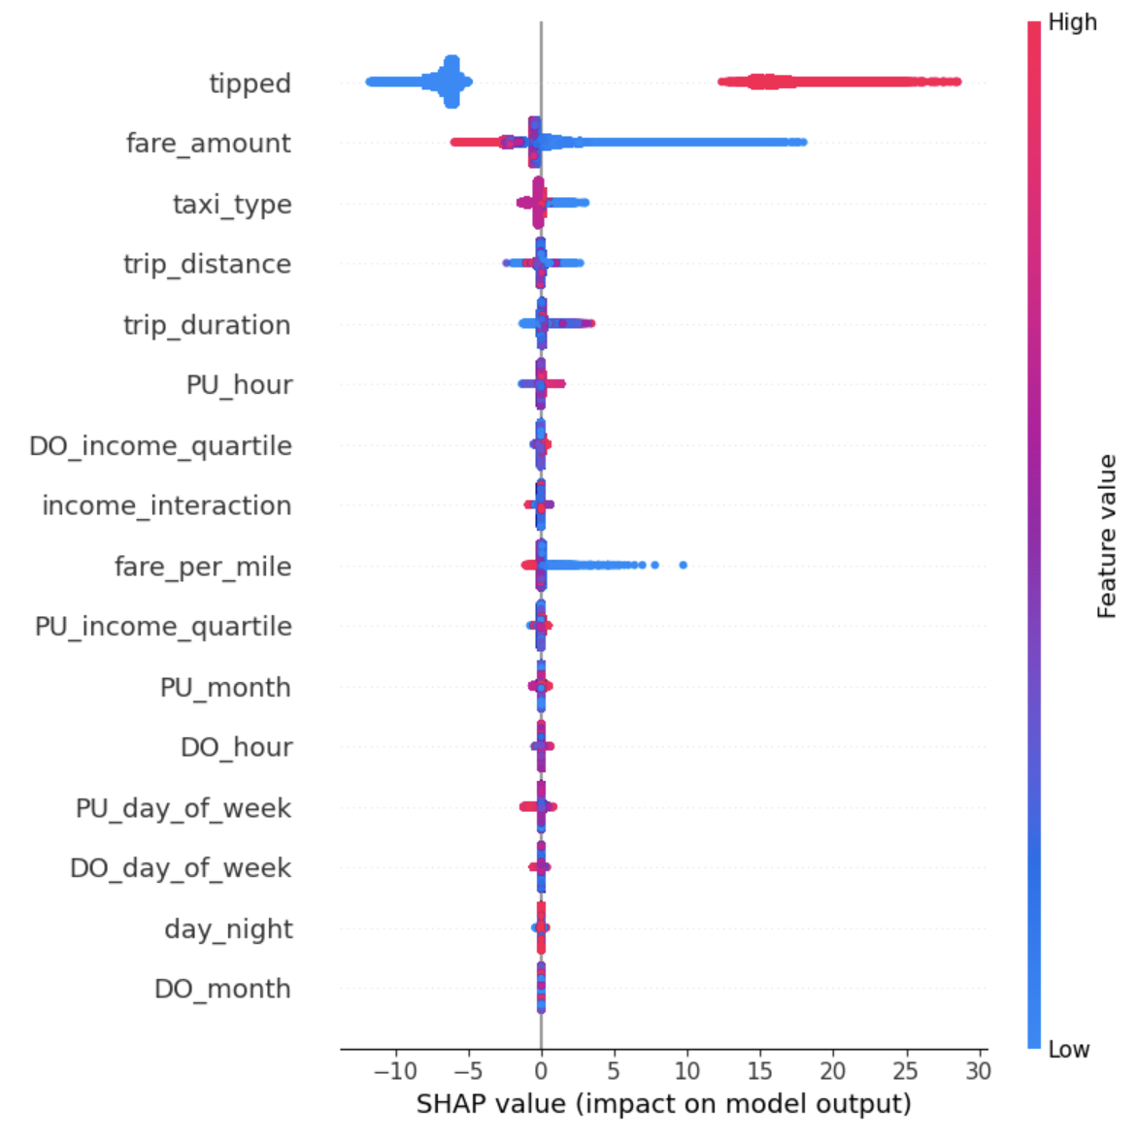
SHAP Analysis
Notes:
HAP tells you:
“For this prediction, how much did each feature push the result higher or lower compared to the average?”
Left: SHAP Force Plot (Single Prediction)
1. Features pushing the prediction up (red bars): These features increase the predicted tip percentage from the baseline. For example:
tipped (value = 1) contributes +14.79
trip_duration and income_interaction also push slightly upward
2. Features pushing the prediction down (blue bars): These features decrease the prediction. For example:
A fare_amount of 34.38 contributes -2.45
A specific taxi_type (code 3) contributes -0.80
A trip_distance of 3.84 lowers the prediction by -0.17
Right: SHAP Summary Plot (Beeswarm)
2. fare_amount also has a strong impact:
High fares (red) tend to increase predicted tip percentage.
Low fares (blue) reduce predicted tips.
3. taxi_type, trip_distance, trip_duration:
For example, certain taxi_type values (like Uber vs Yellow Cab) consistently shift the model’s output in different directions.
Socioeconomic features like income_quartile have lower but still noticeable effects, suggesting neighborhood income matters, but not as dominantly as fare or ride type.

Slide 27
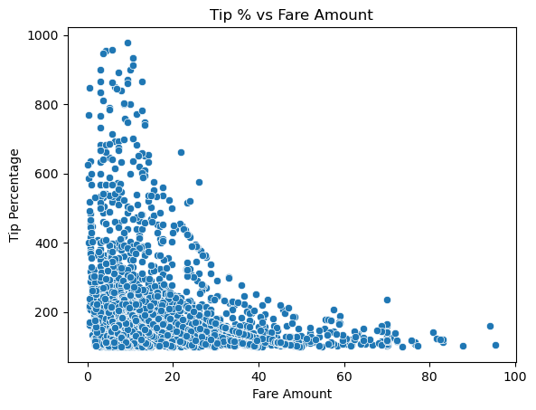
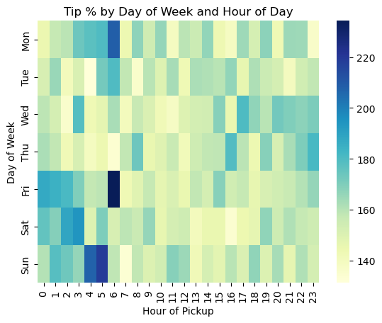
Tip Over 100%
Notes:
High tip percentage regardless of fare amount
Tip % were higher at night time

Slide 28
Conclusion
Key factors of Tip Prediction
Fare amount, taxi type, trip distance/duration, pickup hour
Tipping Behavior
Tip baseline: 15%
No seasonal trends
Positive correlation: trip duration, income interaction, income quartile
Negative correlation: fare amount, trip distance
Uber & Lyft: tipped less
Extreme tipping at night
High variance between tipped and non-tipped rides
Difficulties unveiling socioeconomic factors of tipping behavior
Median income => low impact

Slide 29
Future Direction
Classifier Modeling
Investigate key features for non-tipping behavior
Neighborhood median income, day vs night, short vs. long trips
Light GBM Classifier Model
Efficient for large dataset

Slide 30
Implications for Stakeholders
Government Agencies (MTA, TLC, NYC Planning):
Policy & Equity: Use tipping behavior data to identify socioeconomic disparities in service experiences and improve driver compensation strategies across neighborhoods.
Ride-Sharing and Taxi Companies:
Driver Incentives: Leverage insights to tailor tipping prompts, fare structures, and driver routing strategies to maximize earnings and improve service quality.
Local Communities and Residents:
Transparency & Fairness: Ensure tipping practices are equitable and that drivers serving lower-income areas are not systematically disadvantaged.
Notes:
Government agencies can use tipping behavior data improve driver compensation strategies across neighborhoods
Ride sharing and taxi companies; can leverage insights to tailor tipping prompts
Local communities and residents: can ensure tipping practices are equitable

Slide 31
Ethical, Legal & Societal Implications
Data Privacy and Security
Transparency: Ensure tip data and rider/driver information are handled securely, with ethical data sourcing and responsible usage practices.
Equity and Fairness in Driver Compensation
Inclusivity: Identify and address tipping disparities that may disadvantage drivers serving low-income or underserved areas.
Accountability in Predictive Modeling
Responsibility: Use predictive insights to inform fair practices—avoiding bias in algorithms and promoting equitable outcomes for all drivers regardless of trip location or rider demographics.

Slide 32
THANK YOU

